Slide 1
Introduction to Lean and Lean Training
Vincent Leonard, Director
21st May 2019

Slide 2
6 Trainers
Over 500 projects
22 Consultants
Operational Strategy
Leadership & People Development
Lean Manufacturing
Operational Excellence
Lean in Service Sector

Slide 3
2018
Our students have spent 3,056 days in the classroom
From 162 different companies
We have trained 1,790 people
Over 128 courses
From 162 different companies

Slide 4
Our Clients

Slide 5
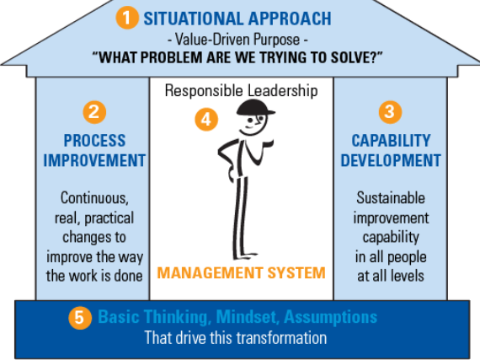
LBSPartners Framework
Training focus

Slide 6
Achieving Balanced Work Flow!
Click to Play - Lucy and Ethel wrap chocolates!

Slide 7
Manager
Problem Solver
What do we do with the backlog of paperwork?
Can you correct an order docket?
Can you fix the photocopier?
Can you get me the correct equipment?
Can you take some work off me as I don’t have time?
What do we do with delivery errors?
I can’t find the necessary documents?

Slide 9
Manager
Problem Solver
What do we do with the backlog of paperwork?
Can you correct an order docket?
Can you fix the photocopier?
Can you get me the correct equipment?
Can you take some work off me as I don’t have time?
What do we do with delivery errors?
I can’t find the necessary documents?
Employee Capabilities
Time to do my actual job!

Slide 10
Lean 101
CUSTOMER
The person who pays for the product or service
Would the customer pay?
LEAN
VALUE
Was the product improved?
Right-First-Time?
WASTE
Tasks & activities that do not add value

Slide 11
Eight Forms of Waste
Manufacturing
Services
T
Transport
Moving bits from one location to another
Multiple Hand-offs or Approvals. Excessive filing of documents
I
Inventory
Excess incomplete work (Work In Process), parts staged
Unfinished Analysis, Reports, Tests. Batch Processing Transactions
M
Motion
Handling of Material, walking, workstation ergonomics
Working on too many Projects at the one time. Searching for files
W
Waiting
Waiting for work from the upstream step
Waiting for Approvals & decisions. Late for meetings. Delays
O
Overproduction
Producing more than required or too much capacity available
Analysis, Reports & Tests not needed. Email to everyone. Extra copies
O
Overprocessing
External setup operations, duplicate operations, redundant operations
Unneeded “Bells & Whistles” for Analysis. Unnecessary or excessive Reports
D
Defects
Failing to produce quality part the first time, rework
Incorrect requirements or input. Order Entry Errors. Lost files. Missing Info
S
Skills
Failing to utilise the skills or capabilities of all the workforce
Inadequate Training. Not enabling people to partake in process improvement

Slide 12
Lean Thinking: A Typical Workplace
Lean takes out waste activities that don’t add value for the customer
Tasks
Activity
Activity
Tasks
Actions
Process
Activity
Actions
Activity
Process
Tasks
Process
Actions
Activity
Tasks
Actions
Process
Process
Activity
Process
Activity
Actions
Tasks
Activity
Activity
Tasks
Tasks
Activity
Lean creates optimum flow of value-adding processes
Tasks
Process
Actions
Actions
Actions

Slide 13
Lean Thinking: A Typical Workplace
Lean looks at the system, takes out waste,
and improves flow.
Process
Process
Process
Process
Process
Process
Process

Slide 14
Progressive Training
MBB
Black Belt
White Belt
Green Belt
Yellow Belt
Master Black Belt – Trains and coaches black belts. Functions at the Six Sigma program level
Black Belt - Lead problem-solving projects. Trains and coaches project teams.
Green Belt – Leads green belt projects, assists with data collection and analysis for black belt projects
Yellow Belt – Participants as a project team member, reviews process improvements
White Belt – Introductory level of knowledge, works in problem-solving teams.

Slide 15
Suitability Matrix
Course | Suitability | Training Days | Mentoring Days | Certification Option | Project Completion
White Belt | The white belt is a basic introduction to lean and is suitable for frontline staff, operatives, reception, interns | Half day | 0 | n/a | No
Yellow Belt | The yellow belt is suitable for operatives and supervisors who have no formal problem solving training or experience but who may have management potential | 2 Days | 1 | Yes | Yes
Green Belt | The Green Belt is suitable for those that have already completed their yellow belt or managers and supervisors who are with the organisation over 3 years and require advanced problem solving capability | 5 Days | 4 | Yes | Yes

Slide 16
The DMAIC Methodology
D
Define the challenge or improvement opportunity
M
Measure current process performance
Analyse the process to determine the root cause of poor performance
A
I
Improve the process by attacking the root causes
C
Control the improved process to hold the gains

Slide 17
Using DMAIC A3
1. Background
DEFINE
5. Counter-Measures
IMPROVE
2. Current Condition
DEFINE / MEASURE
6. Results
IMPROVE
3. Goals / Targets
MEASURE
7. Follow-Up
CONTROL
4. Analysis
ANALYSE

Slide 18
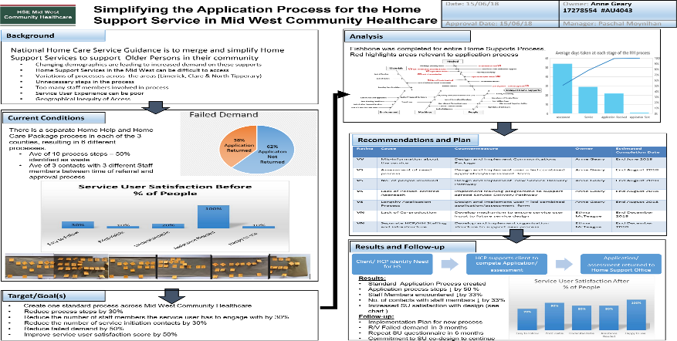

Slide 19
Example of Lean
Click to play - Lean Thinking Case Study | City Hotel Derry | Eliminate Waste

Slide 20
Why Mentoring?

Slide 21
Why Mentoring?
Knowledge Transfer of Problem Solving
“Learn As You Do”
Correct use of tools
Experience
Challenge Status Quo
New Thinking
Deeper Understanding

Slide 22
Shared Learning
Manufacturing
Hospitality
Pharmaceutical
Construction

Slide 23
Thank you for your time and please feel free to ask any questions

